Slide 1



Market analysis
View in Power BI
Last data refresh:
20/08/2022 20:04:53 UTC
Downloaded at:
20/08/2022 20:07:58 UTC

Slide 2
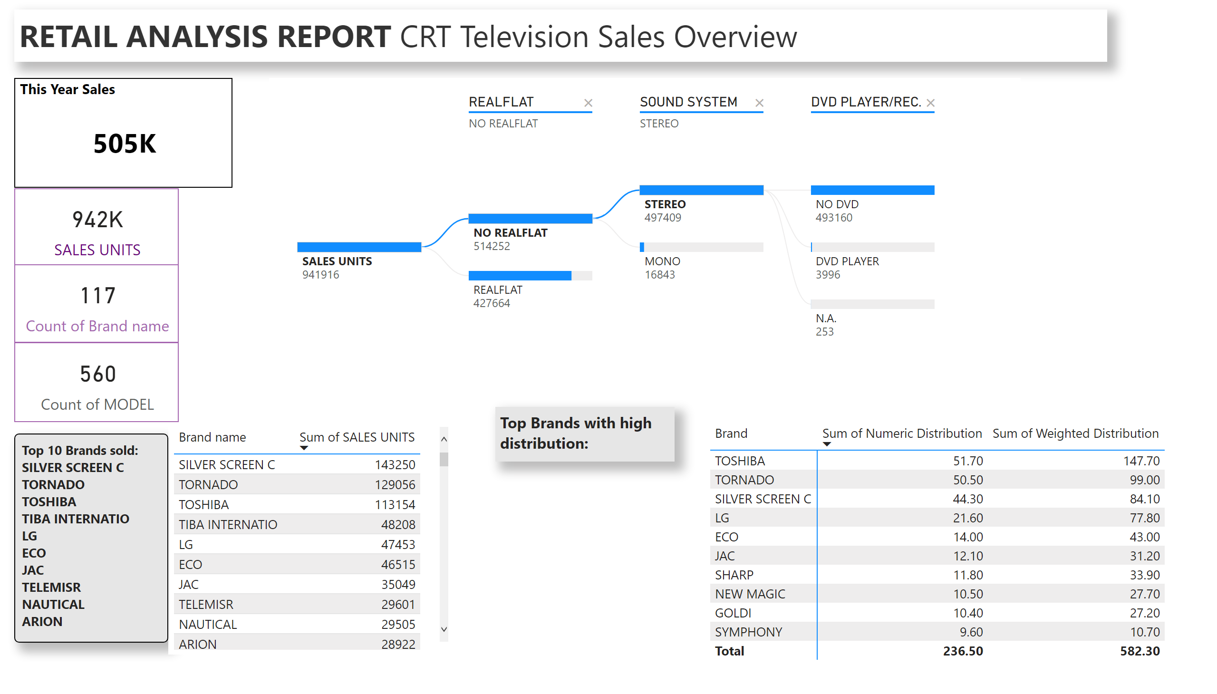
An Overview
Notes:
SALES AND MARKETING
No alt text provided
This Year Sales
No alt text provided
card
No alt text provided
card
No alt text provided
card
No alt text provided
decompositionTreeVisual
No alt text provided
textbox
No alt text provided
tableEx
No alt text provided
pivotTable
No alt text provided
textbox
No alt text provided

Slide 3
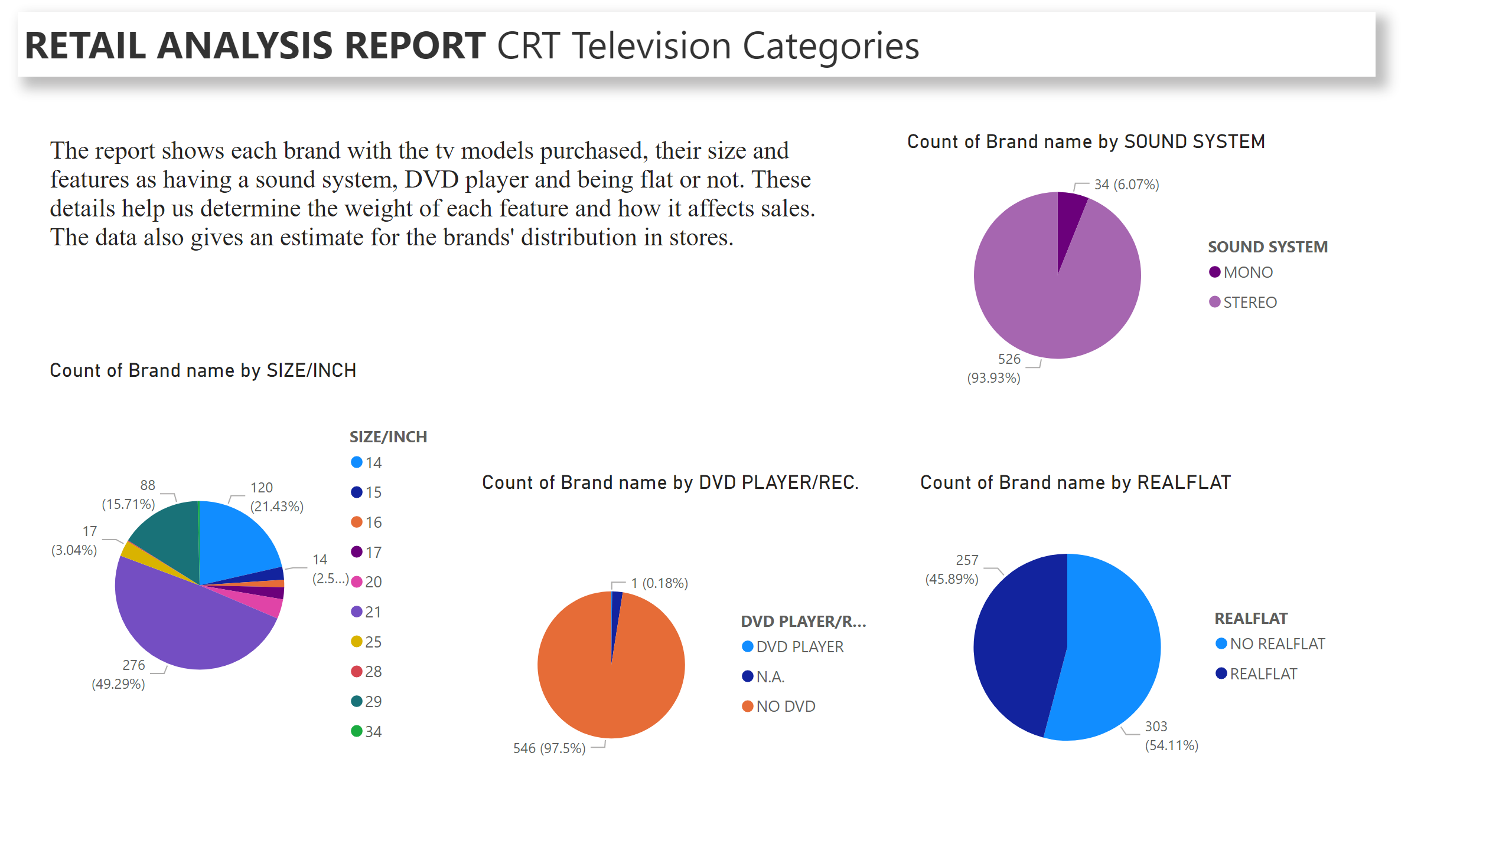
Data Structure
Notes:
pieChart
No alt text provided
pieChart
No alt text provided
pieChart
No alt text provided
pieChart
No alt text provided
SALES AND MARKETING
No alt text provided
textbox
No alt text provided

Slide 4
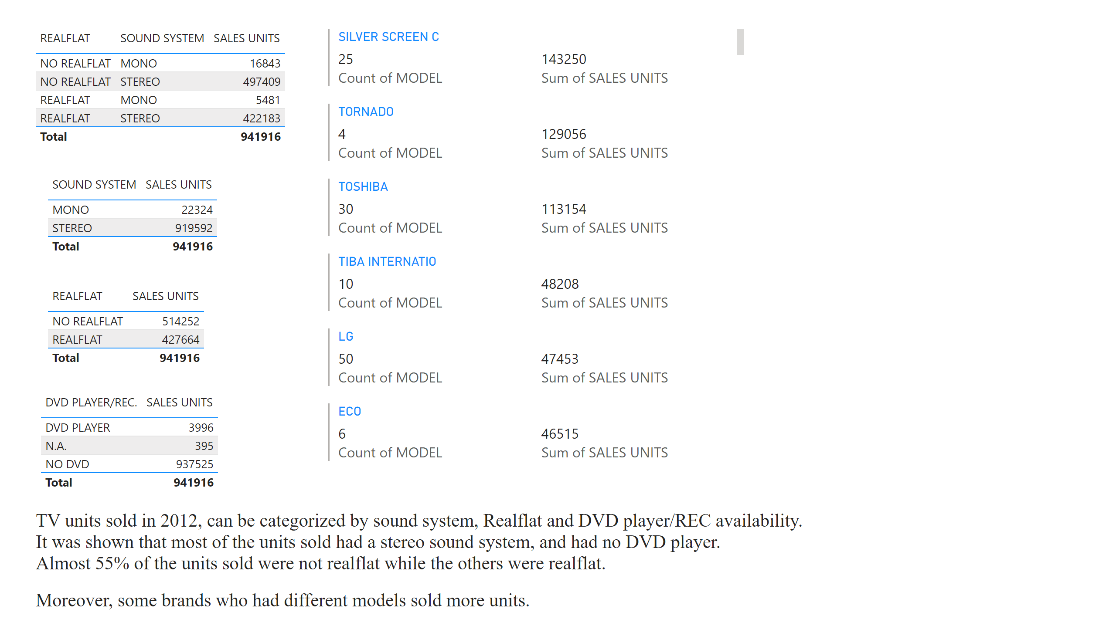
Sales Units VS Features
Notes:
tableEx
No alt text provided
tableEx
No alt text provided
tableEx
No alt text provided
textbox
No alt text provided
tableEx
No alt text provided
multiRowCard
No alt text provided
textbox
No alt text provided

Slide 5
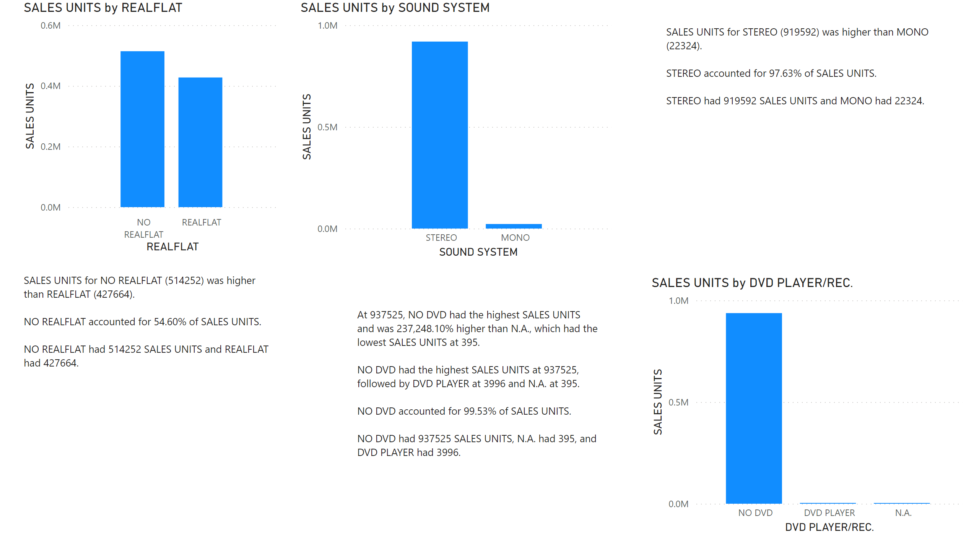
Sales Units VS Features
Notes:
textbox
No alt text provided
columnChart
No alt text provided
textbox
No alt text provided
textbox
No alt text provided
columnChart
No alt text provided
columnChart
No alt text provided

Slide 6
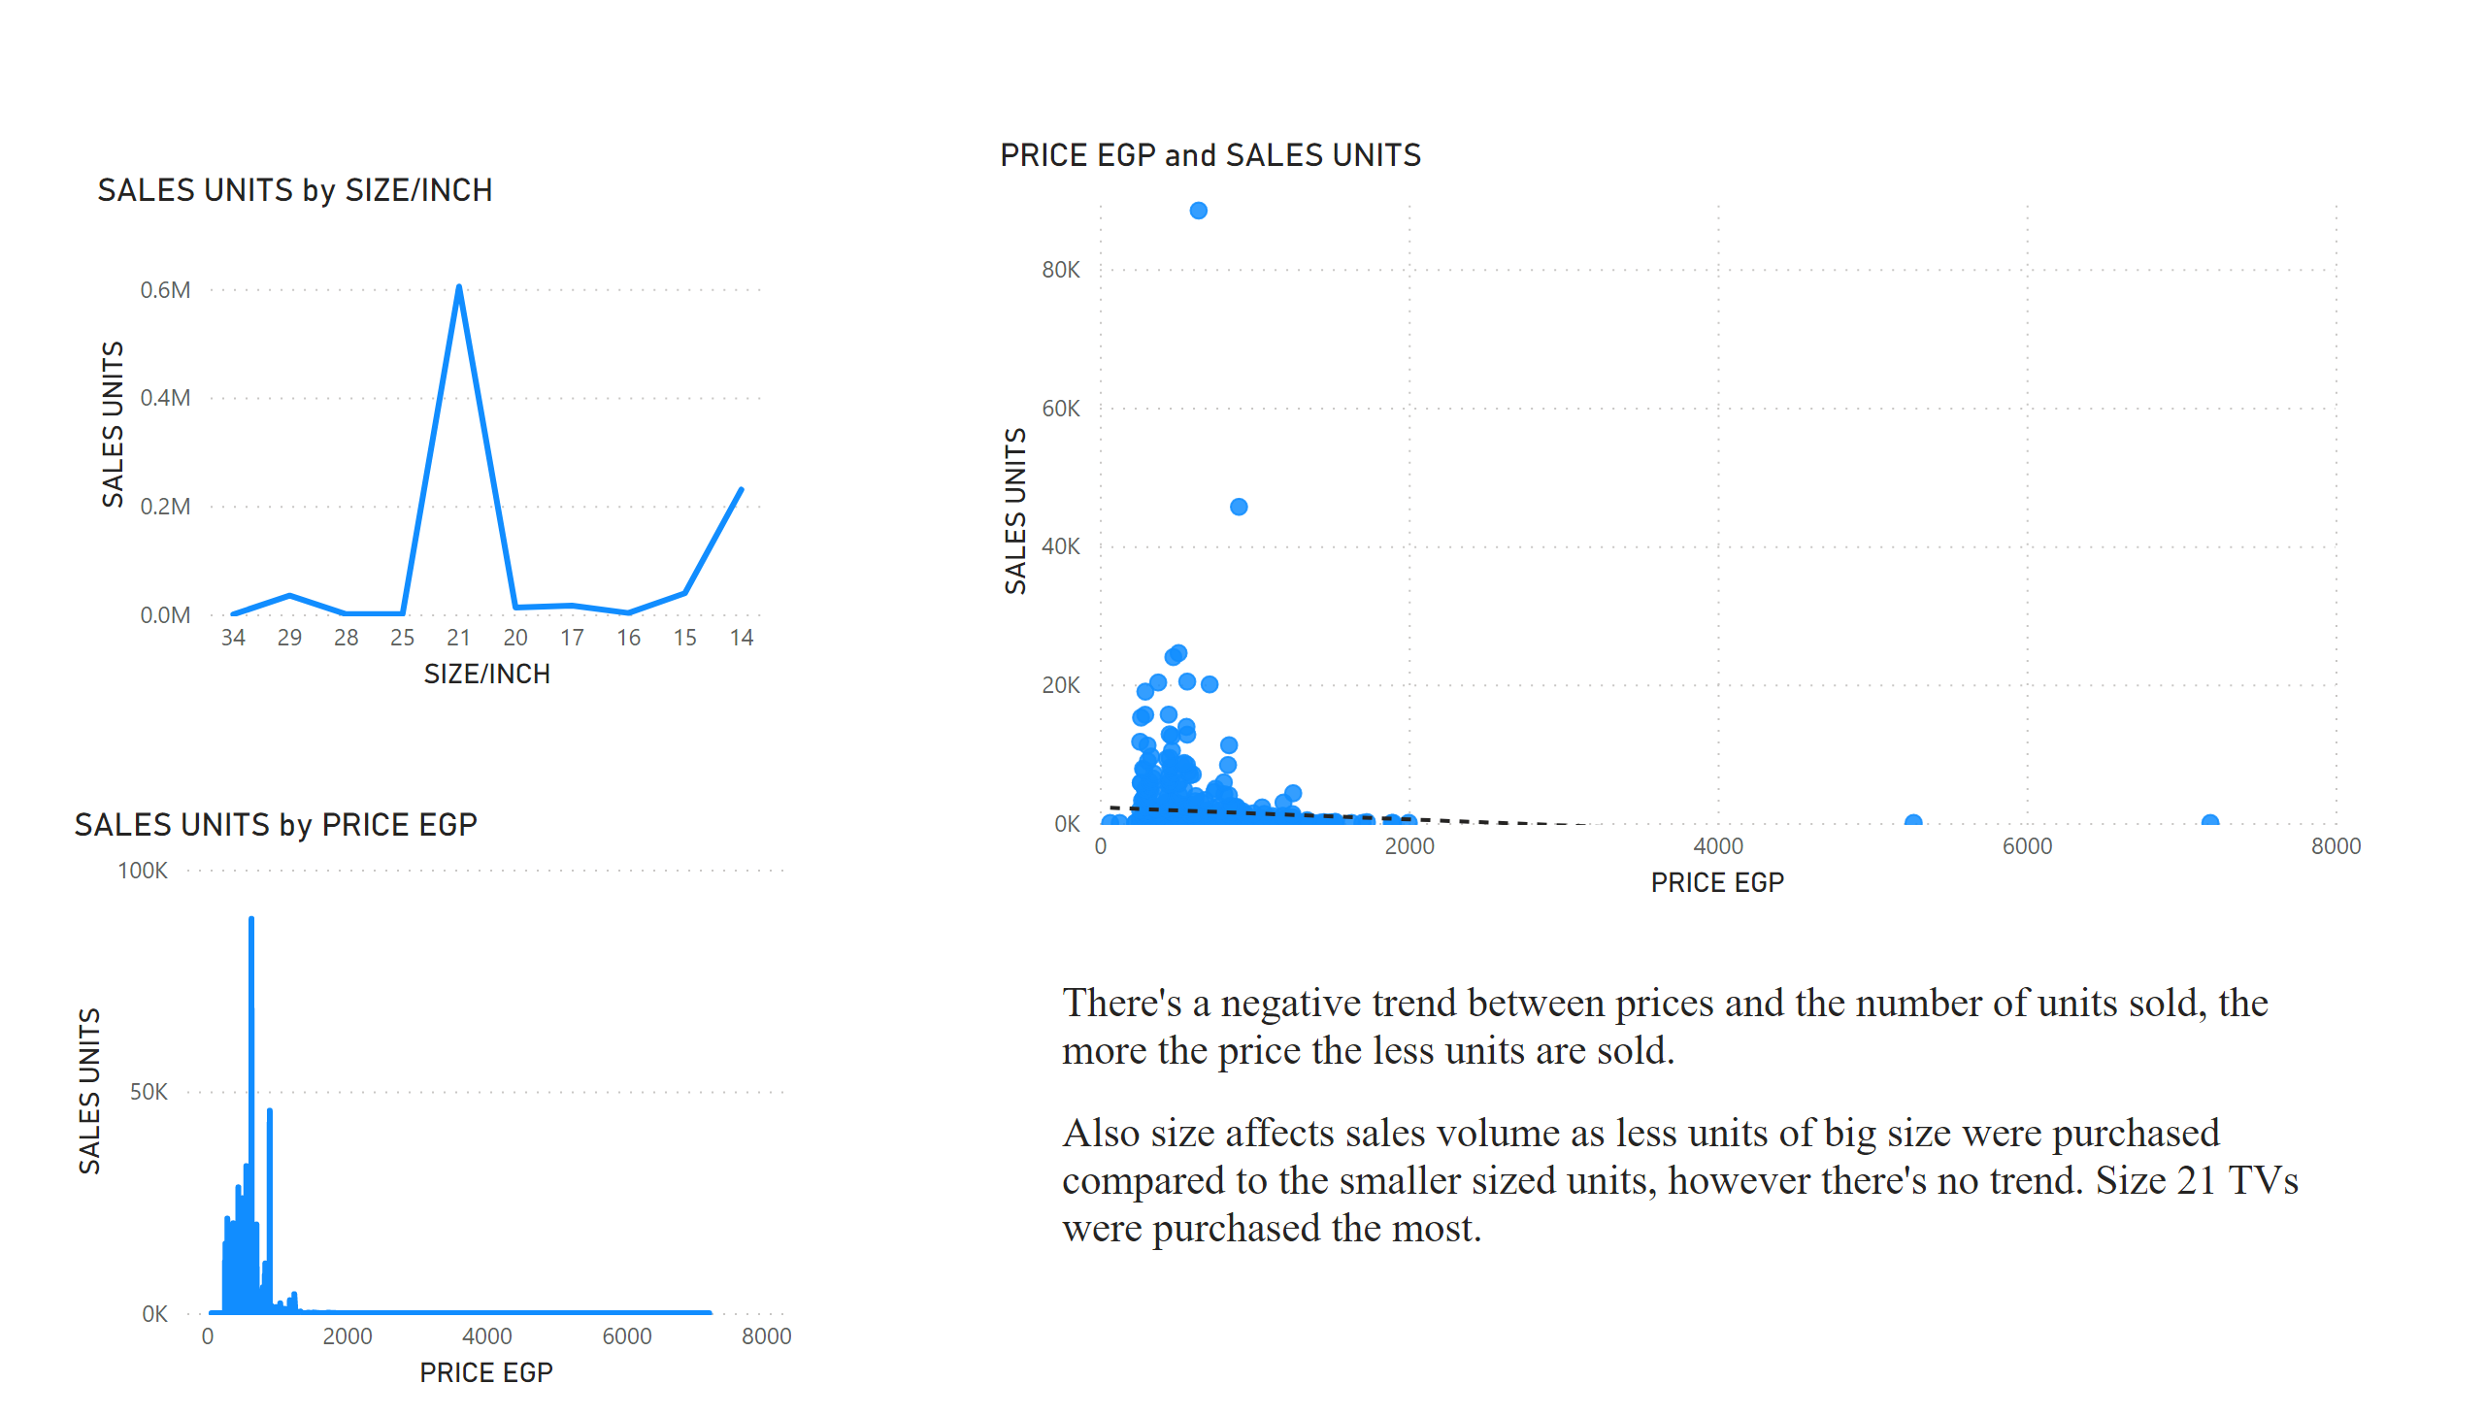
Price and Size VS Sales
Notes:
lineChart
No alt text provided
lineChart
No alt text provided
scatterChart
No alt text provided
textbox
No alt text provided

Slide 7
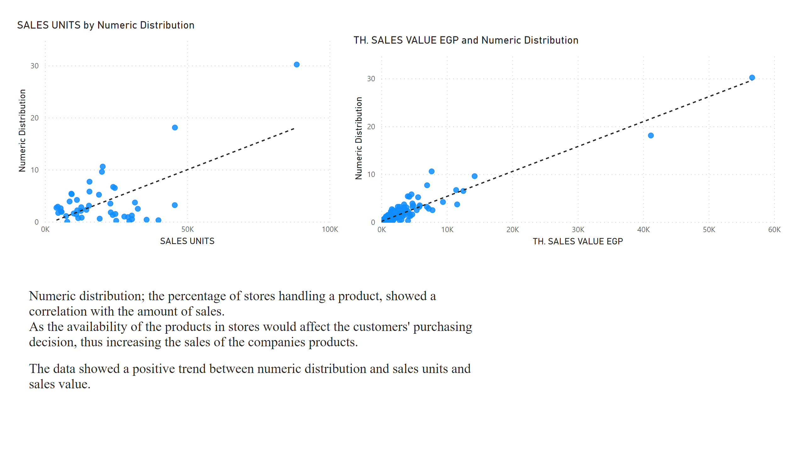
Distribution VS Sales
Notes:
scatterChart
No alt text provided
scatterChart
No alt text provided
textbox
No alt text provided

Slide 8
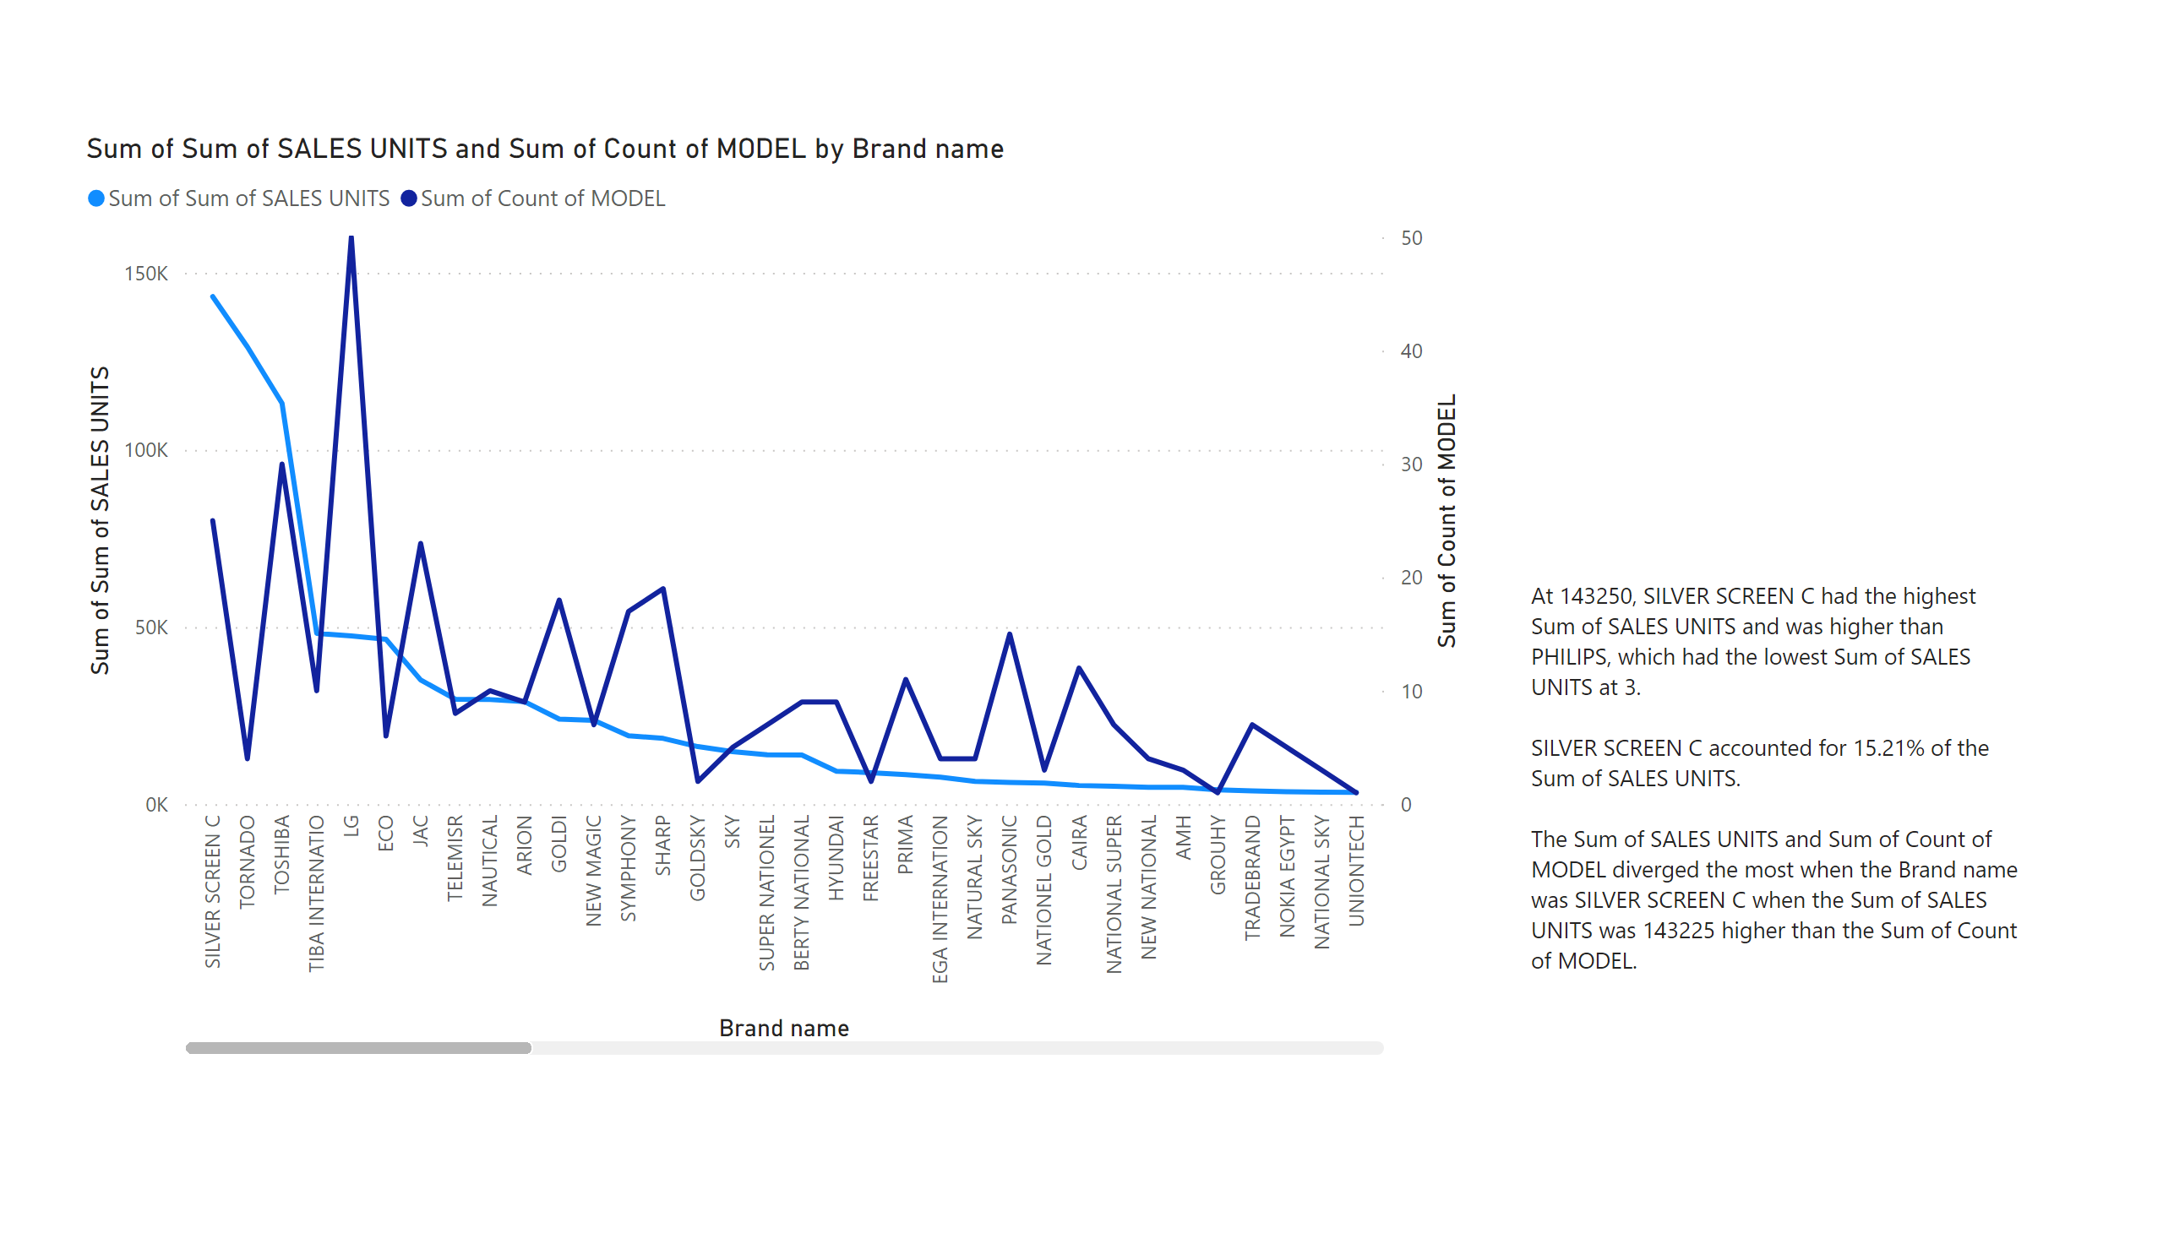
Brand, model & Sales
Notes:
lineChart
No alt text provided
textbox
No alt text provided

Slide 9
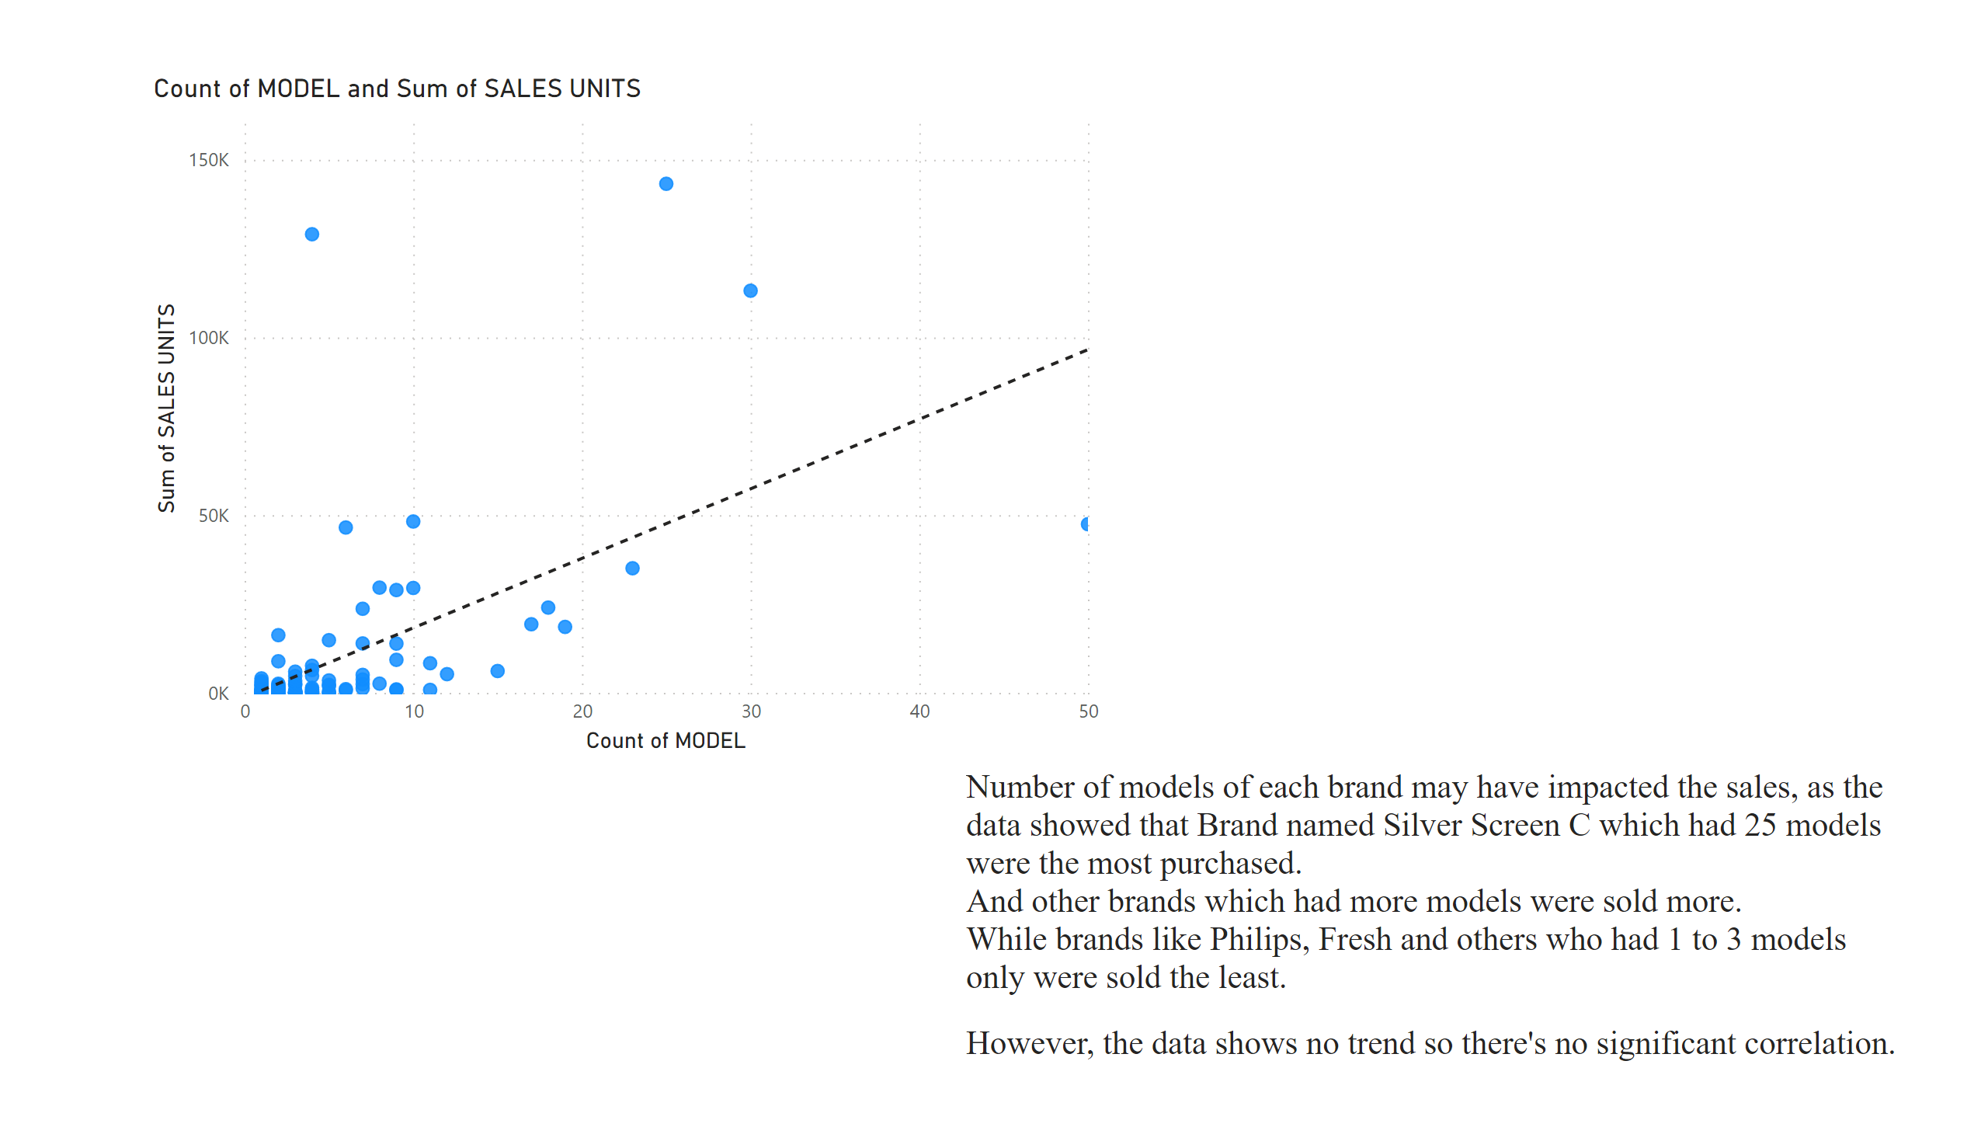
Models & Sales
Notes:
scatterChart
No alt text provided
textbox
No alt text provided

Slide 10
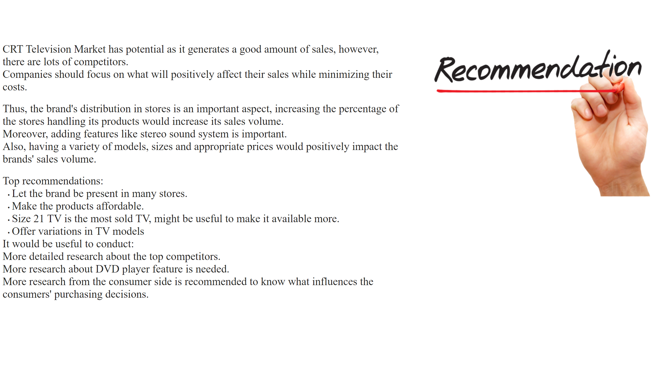
Recommendations & Way forward
Notes:
textbox
No alt text provided
image
No alt text provided
textbox
No alt text provided

